Slide 1

Gain and Phase Analyzer
Interim Report
May 8, 2015
Notes:
Kaidi

Slide 2
Agenda
Purpose
Requirements
Design
Schedule
Budget
Next Steps
Notes:
Kaidi

Slide 3
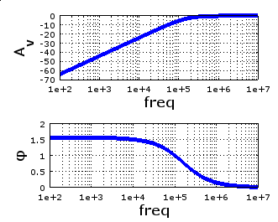
Purpose
Test the performance of filters, amplifiers
Generate Bode plot with
amplitude and phase
Notes:
Kaidi

Slide 4
Uses
Education
Testing, design, characterization of:
Signal filters
Signal amplifiers
Control systems
Notes:
Chris

Slide 5
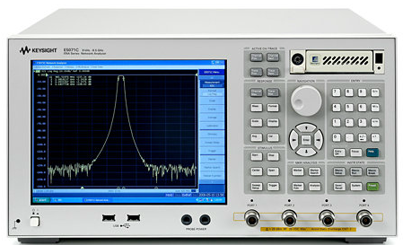
Why?
Current state of industry
Large
Expensive
Learning curve
Students can’t see how it works!
Our Goal
Portable
Cost around $200
Easy to use for students and teachers
Open source
Image: Keysight Technologies, “E5071C ENA Series Network Analyzer”
Notes:
Chris

Slide 6
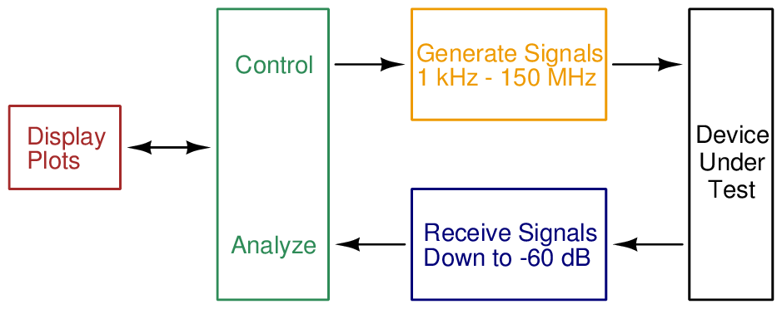
Requirements
Notes:
Chris

Slide 7
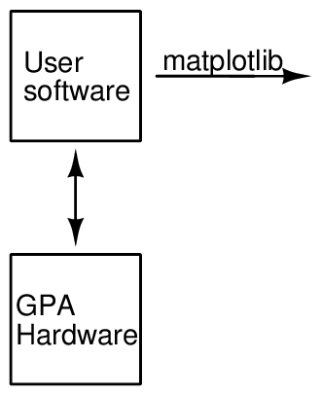
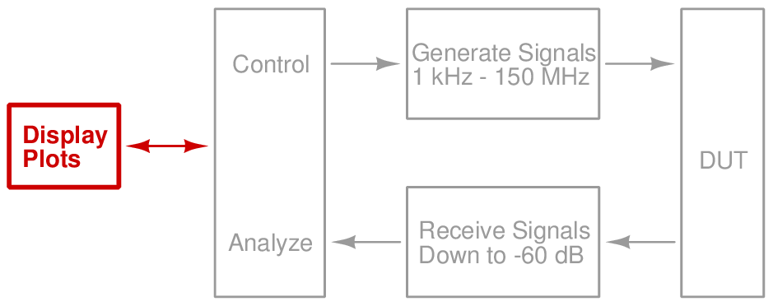
Design — Software
Notes:
Harrison

Slide 8
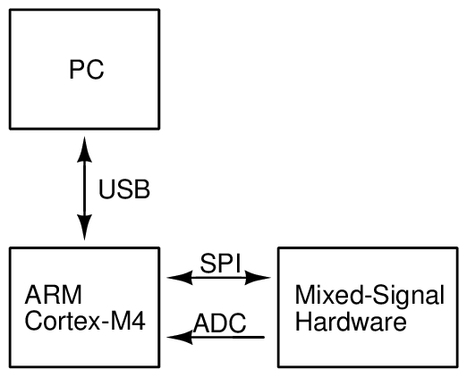
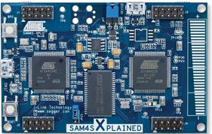
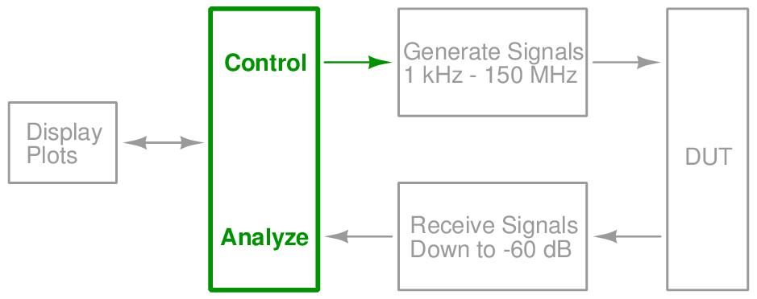
Design — Microcontroller
Notes:
Harrison

Slide 9
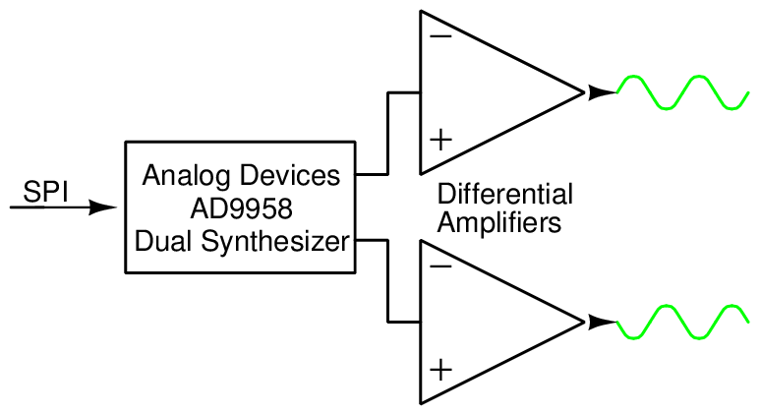
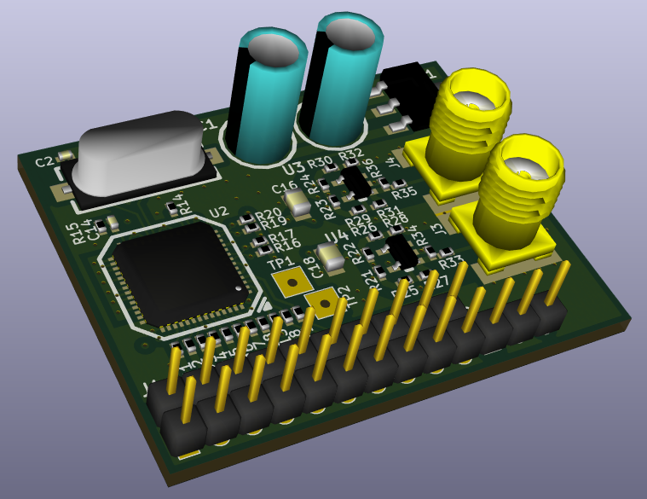
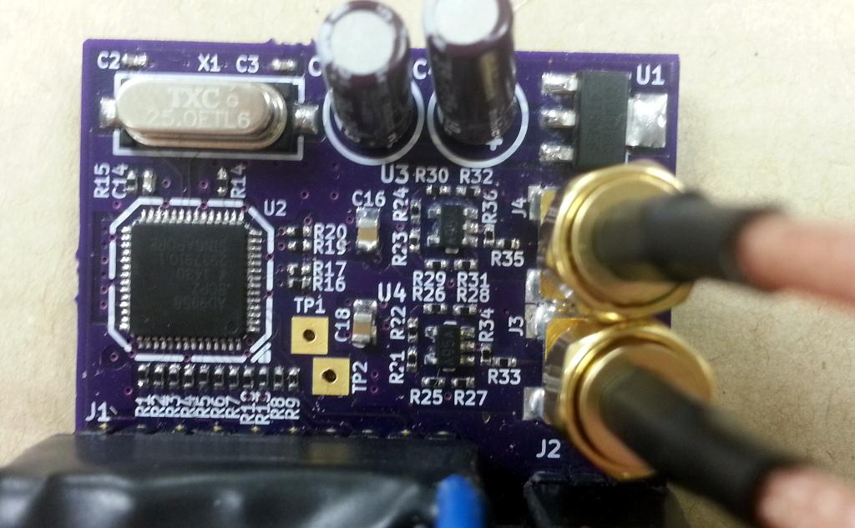
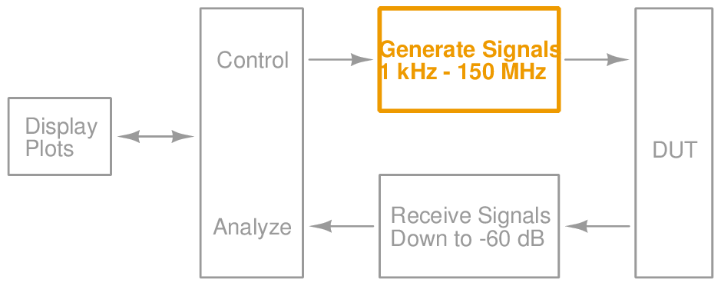
Design — Signal Generation
Notes:
Ken

Slide 10
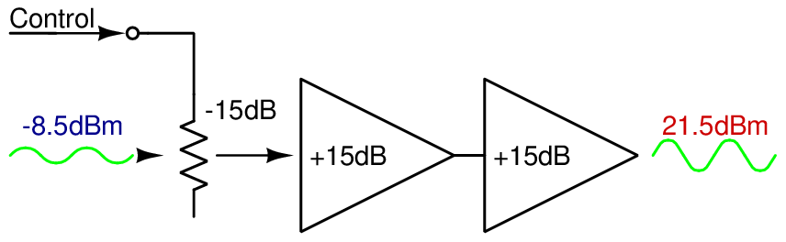
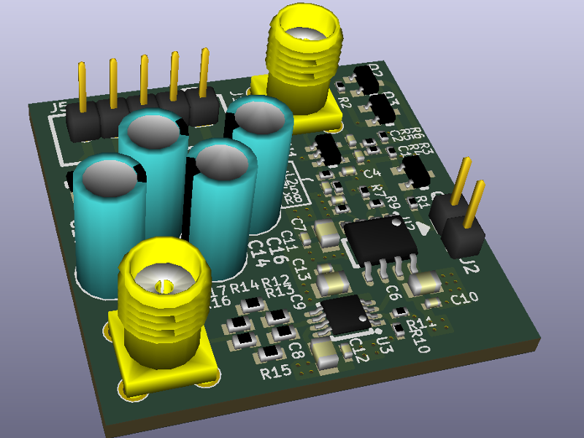
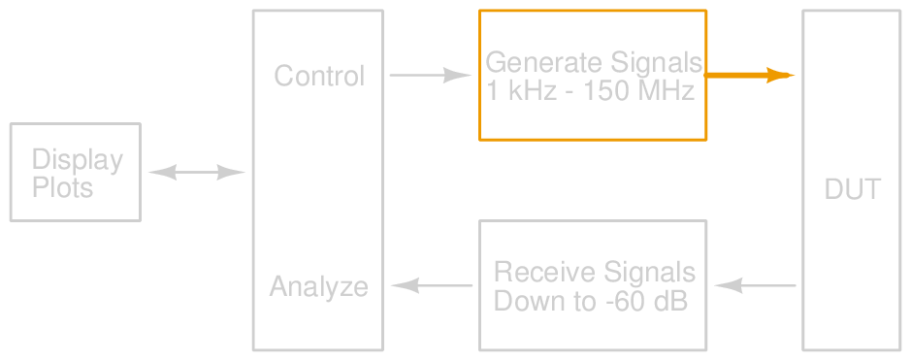
Design — Signal Output
Notes:
Ken

Slide 11
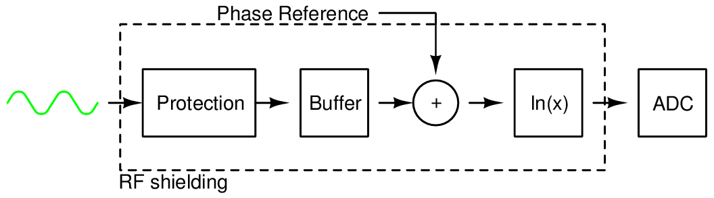
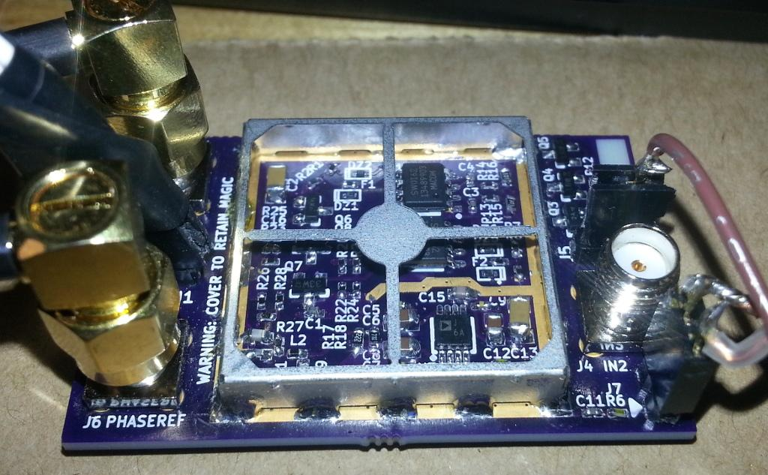
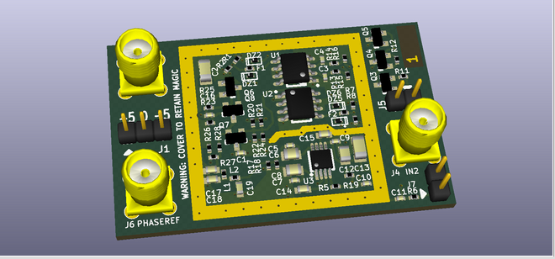
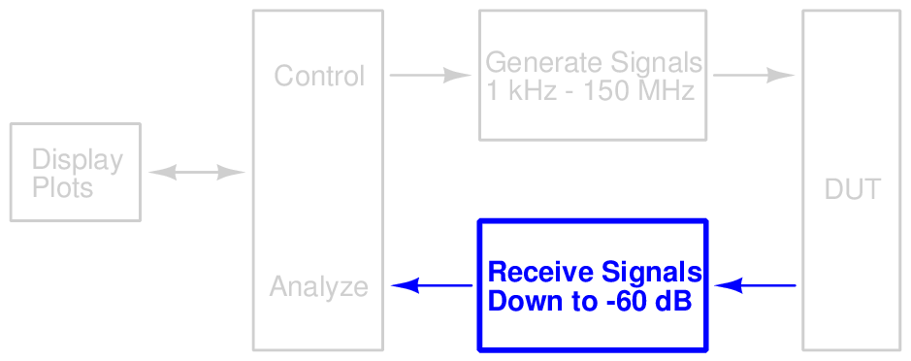
Design — Detection
Notes:
Chris

Slide 12
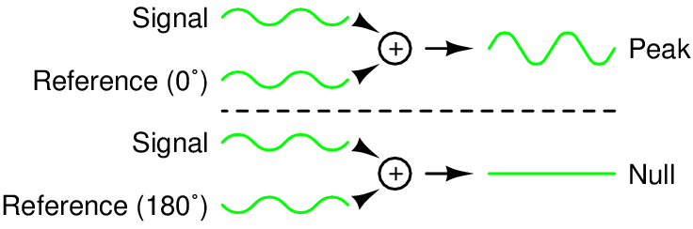
Design — Phase Detection
Notes:
Chris

Slide 13
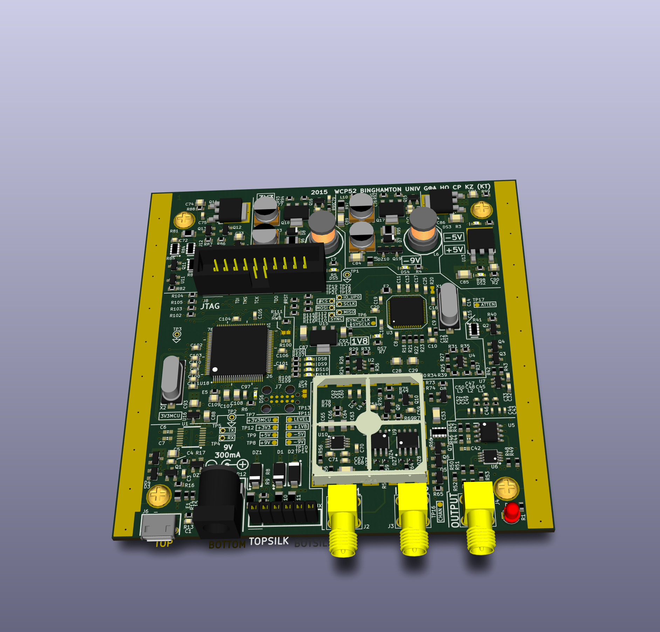
Design — PCB
Notes:
Harrison

Slide 14
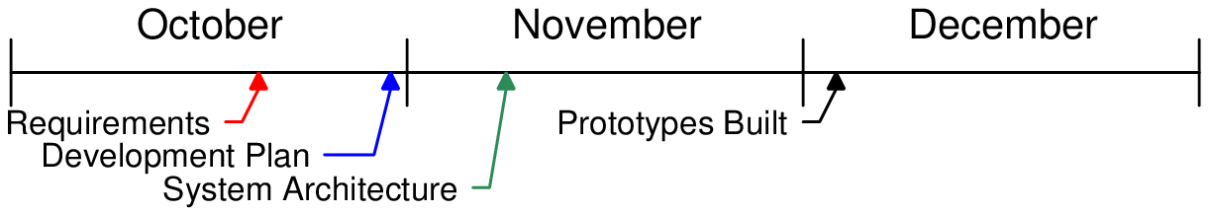
Timeline
Notes:
Harrison

Slide 15
Schedule
Item | Start Date | End Date | Percent Complete
Specification | 2014-10-03 | 2014-10-17 | 100%
Development Plan | 2014-10-17 | 2014-10-31 | 100%
Architecture | 2014-10-31 | 2014-11-14 | 100%
Interim Report | 2014-11-14 | 2014-12-05 | 100%
Proto. built | 2014-11-14 | 2014-12-05 | 100%
Proto. firmware | 2014-11-10 | 2014-12-05 | 100%
Notes:
Harrison

Slide 16
Budget
Item | Expended | Actual | Estimated to Completion | Estimated at Completion
Synthesizer | $60 | $60 | $0 | $60
Input | $70 | $70 | $0 | $70
Output amp. | $66 | $66 | $0 | $66
Power supply | $0 | $0 | $0 | $0
Final build | $0 |  | $120 | $120
Enclosure | $0 |  | $30 | $30
Misc/re-spins | $0 |  | $100 | $100
Total | $196 | $196 | $250 | $446
Notes:
Harrison

Slide 17
Next Steps
Hardware
Combine prototypes into a final product
Software
Finish firmware with full analysis capability
Write PC software that receives and plots data
Calibration
Finalization
Operating manual
Software packaging and installation
Notes:
Ken

Slide 18
Conclusion
Product can capture Bode plots
Uses signal synthesizer, output amplifier, input frontend, ADC, and microcontroller
These have been prototyped and tested
Notes:
Kaidi

Slide 19
Demo

